Slide 1
Round Table & Directors’ Meeting
July 15, 2022

Slide 2
Agenda
9am-10am
General Updates
Referral Pathways into Centers
Program Expectations
Meeting Dates & Training
10am-11am
Q&A and Site Director discussion

Slide 3
Updates
Welcome to the first joint Round Table and Director meeting!
Family Strengthening Team – Congrats Emily and Welcome Claire!

Slide 4
Family Strengthening Programs
Family Center | Family Center w/ approved model Home Visiting | Home Visiting (approved model)
Carnegie | Braddock/Rankin | East Allegheny
East Hills | Clairton | Family & Immigrant Connection
East Liberty (Kingsley) | Duquesne | Lincoln Park
Hazelwood | Highlands | Sto-Rox (+ Fatherhood drop-in center)
Hill District | Hilltop | Wilkinsburg (AIU)
Homewood Brushton | Latino
McKees Rocks (FOR) | Lawrenceville
Northside (Providence) | McKeesport
Northview Heights | Penn Hills
Wilkinsburg (Hosanna House) | South Hills (SHIM)
 | Steel Valley
 | Turtle Creek

Slide 5
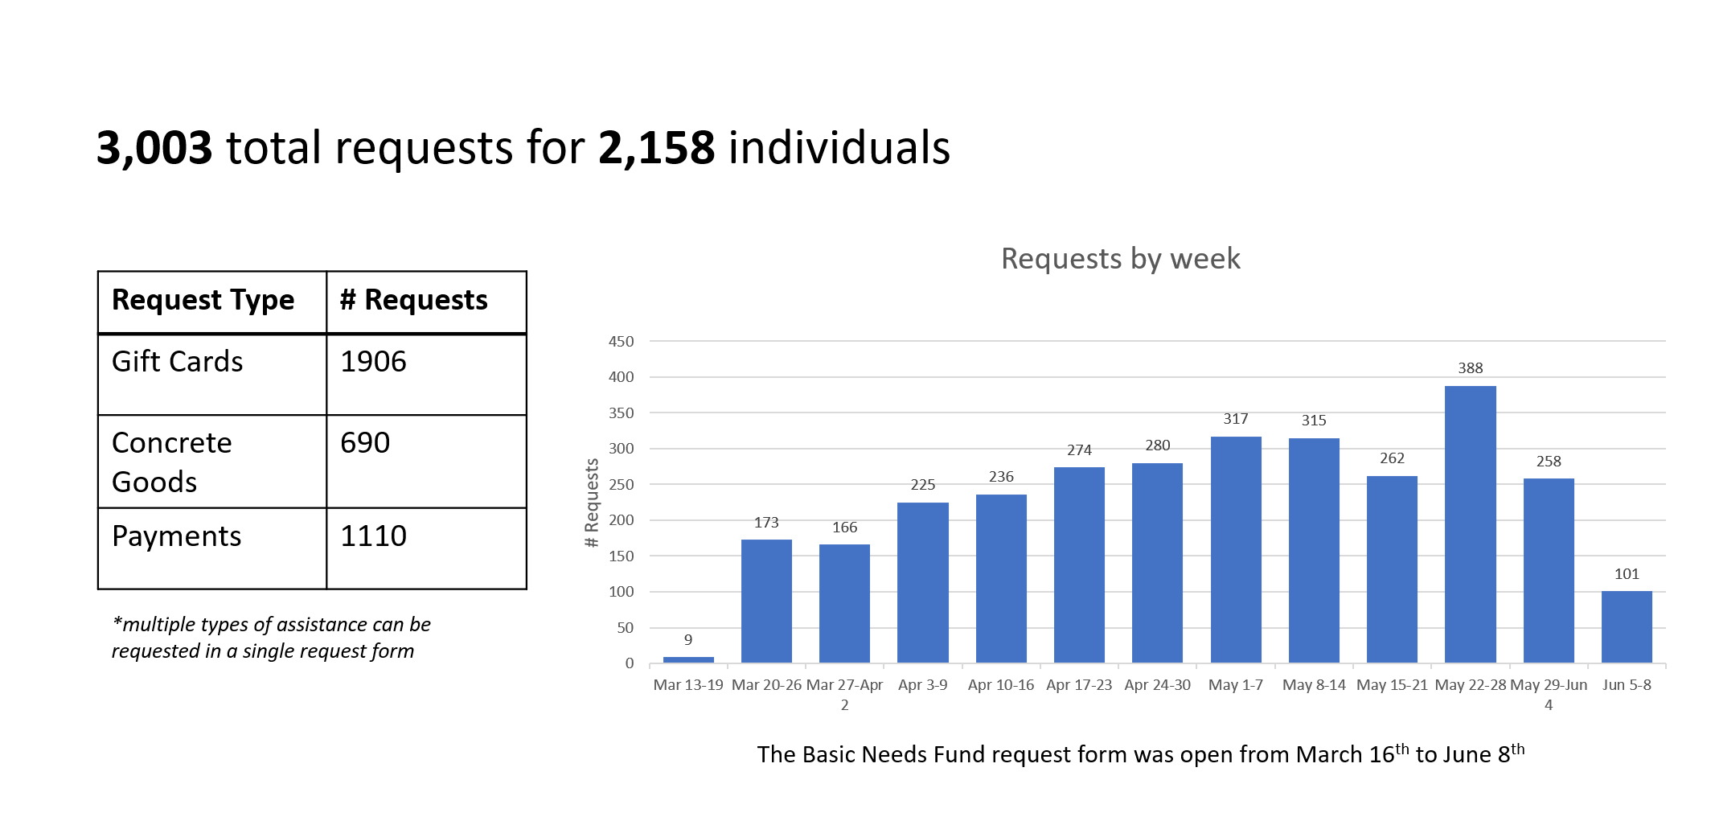
Basic Needs Fund (1 of 2)

Slide 6
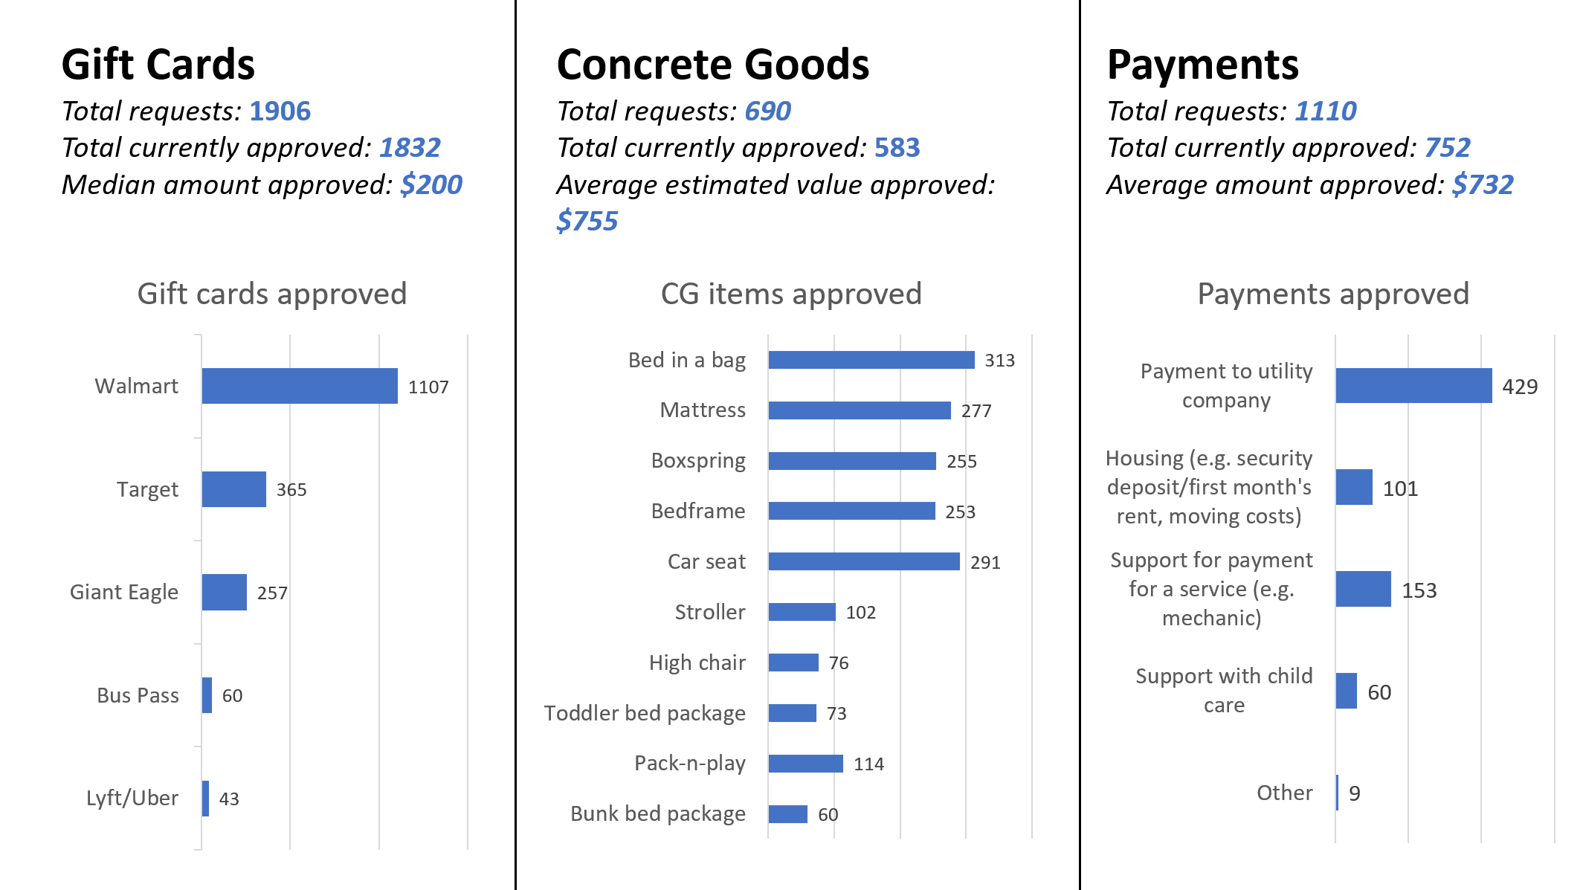
Basic Needs Fund (2 of 2)

Slide 7
Referrals Pathways into Family Centers
We want you to outreach in community and enroll as many families as possible in your center!
In addition, we continue to build out key centralized referral pathways into centers:
Early Learning Resource Center (Families have children ages 0-12 + variety of needs/interests)
Hello Baby (Families have children <6 months + variety of needs/interests)
Link (Families could have children of any age)
All of these centralized referrals will come through Synergy, expectation is to review contact notes and reach out to family within 2 business days. When you reach out to families, you should get a sense for their needs and interests and decide together how you can best support the families.
In most instances, Home Visiting only programs will not receive direct referrals from these sources, unless the family wants to enroll in HV from the start.

Slide 8
Centralized Outreach Overview
•Initial plan for connecting with families referred through Hello Baby was for each provider to reach out and promote their services to families with newborns
•What we know/learned over past 1.5 years of implementation…..
Family’s contact info is old/inaccurate, takes a long time to find family, and the process doesn’t help to connect with referred families.
Some providers identified specific staff to coordinate outreach and follow up activities for HB referred families. This resulted in various styles of outreach and engagement efforts throughout the county for families to experience.
Many HB families with moderate to high needs are in crisis [food instability, pending eviction, unemployment, other basic needs] that require attention before committing to a support program
•How our thinking has evolved…….
What if we developed and tested a process that takes the initial burden off the providers of finding accurate contact info, attempting AND connecting with families, better understand what works and what doesn’t’, and develop a more standard outreach process for families to experience throughout the county????

Slide 9
What does this mean for Family Centers?
Beginning late July, all Hello Baby referrals will first be picked up by a centralized outreach team member** who will connect with families, assess needs, promote family center participation and HB welcome bag distribution, complete FYC app for initial distribution, and refer to local family center.
Once the centralized team connects with the family, they will show up in Synergy with a note describing family’s needs and activities completed by CO prior to making the referral, along with accurate family contact information.
This means that families you will be receiving have already been in contact with the CO team, have agreed to family center services, and will be expecting the family center to reach out to them. First step should include welcome bag drop off.
**CHP FCC Centralized Outreach team will connect with hospital referrals (Leah, Arianna, Alexa)
**DHS centralized outreach team will connect with PRM referrals (Tara, Camille, Danya'le)
**ELRC resource navigator will connect with ELRC referrals (Becky, Shelby, Robert)
Note: For families with babies already enrolled in your center or new families who walk in, you should sign them up for First Year Cheer directly, no need to engage the centralized outreach team!

Slide 10
Resource Navigation team (scaling from ELRC referral team)
Assess immediate needs, provide basic coordination and referrals, enter and transfer cases in Synergy, give resource information/support to providers
Family Centers
What services are available to ALL families?
Drop-in/Phone– someone is available to welcome families without an appointment in person and by phone
General intake – complete intake & needs assessment (staff can use FAST for more intensive families)
Basic service coordination –able to assist with basic supports (housing, employment, home visiting, Headstart/EHS, Neighborhood Legal Services, AFN, etc.)
Benefits enrollment – make appointments to complete benefits applications; assist with making calls and follow-ups as needed
Access to resources – provide diapers, connections to food and transportation services, FYC/formula bank, utilities assistance, RHRT
What if the family needs more support?
Refer to Emily/Claire and consult with the Resource Navigator
Refer to FACT or ISAC
Approved Home Visiting programs
What services are available to HV families?
General intake*
Basic service coordination*
Benefits enrollment*
Access to resources*
*FOR ENROLLED FAMILIES ONLY
What if the family needs more support?
Refer to Emily/Claire and consult with the Resource Navigator
Refer to FACT or ISAC
FCs & HV can consult with Navigation team regarding these supports. Families can also be referred directly to these supports.
Behavioral Health
Housing Supports
Employ-ment
Early Childhood
FACT
Family Checkup
Other (TBD)

Slide 11
Family Center Program
Hybrid (Family Center + Home Visiting)
Home Visiting (Approved Model)
EVALUATE: review notes on referred families, conduct intake & needs assessment
SUPPORT: build relationship with family and…
connect to basic services
help them get enrolled in benefits
refer to appropriate local and neighborhood-specific resources/services
STABILIZE: provide case management services as needed and assist with goals and identified needs
AFTER DELIVERING INITIAL SERVICES
CONSULT: If the center is struggling to move the family toward stabilizing, the center can consult with Resource Navigator about what steps to take or what resources are available for more intensive need areas.
ELEVATE: if it becomes clear the family needs 1:1 support, or little progress is made after ~6 months, refer family to an intensive program.
ONGOING
TRAIN – all staff will participate in regular human services training to stay up-to-date on resources and service offerings.
EVALUATE: review notes on referred families, conduct intake & needs assessment
SUPPORT: build relationship with family and…
connect to basic services
help them get enrolled in benefits
refer to appropriate local/neighborhood resources
Provide interim support if the home visiting caseloads are full / waitlisted
STABILIZE: If family has higher level of need that requires case management, enroll in home visiting program or provide other case management service to assist with goals and identified needs
AFTER DELIVERING INITIAL SERVICES
CONSULT: If the center is struggling to move the family toward stabilizing, the center can consult with Resource Navigator about what steps to take or resources are that available for more intensive need areas.
ELEVATE: if it becomes clear the family needs 1:1 support, or little progress is made after ~6 months, refer family to an intensive program.
ONGOING
TRAIN – all staff will participate in regular human services training to stay up-to-date on resources and service offerings.
EVALUATE: review notes on referred families, conduct intake & needs assessment
If home visiting caseloads are full, refer to a nearby FC for interim support while family stays on waitlist
ENROLL/STABILIZE: If family requires 1:1 support or case management, enroll in home visiting program. Assist with basic needs, service coordination, and benefits enrollment as needed.
CONSULT: If the center’s home visiting program is full, consult with Resource Navigator about what other resources/programs may be appropriate to refer the family to; offer to keep on a waitlist for home visiting, but connect to other recommended services and programs in the meantime
ONGOING
TRAIN: all staff will participate in regular human services training to stay up-to-date on resources and service offerings; home visiting staff should support families with these resources as issues arise during visits

Slide 12
Synergy & Monitoring
Home Visiting Only
All families should be enrolled in Home Visiting or on the waitlist
Required Info: same as previous years
Contact Expectations: per home visiting programs requirements
Family Center Only
Close all families currently enrolled in Home Visiting
Can have “case management” families receiving informal home visits
Case management (i.e. “enrolled”) families should have some indication of a needs assessment, i.e. intake form
Required Info: name, birth gender (or social security number), birthdate, updated phone number. All contacts/group events/referrals are recorded
Highly Encouraged Info: family needs/interests (updated yearly), household members (include race/ethnicity), service involvement, pregnancy info
Contact Expectations:
Walk-ins/Drop-ins: attempted contact once per quarter; inactive after one year of no contact
Case Management/Enrolled: attempted contact once per month; move off of case management after 90 days of no contact
These expectations will be reviewed during monitoring
Hybrid (Family Center + Home Visiting)
Same as above; only families receive an approved HV model should be listed as “enrolled” in home visiting. All others are enrolled in the center, but not home visiting.
***SYNERGY GUIDANCE DOCUMENT FORTHCOMING**

Slide 13
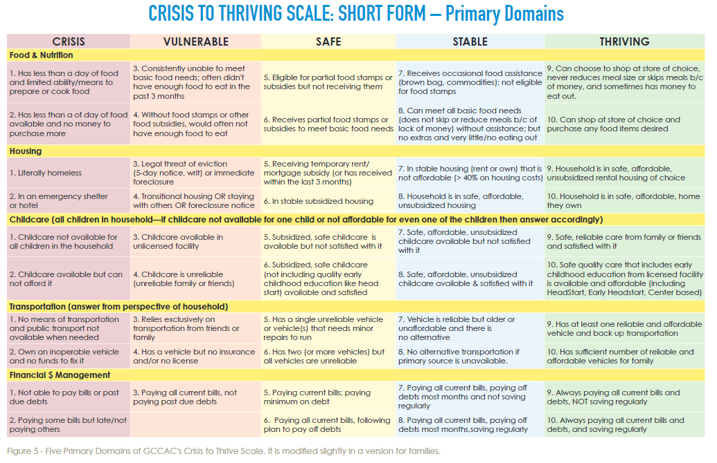

Slide 14
Training to make all this work!
ClientView for Program Directors
Monday, July 25th 2-3pm
Friday, August 5th, 11am-12pm
FAST
Human Services 101
Session 1: Benefits Navigation
Referrals beyond the scope of your center – send to Emily (Emily.bengel@alleghenycounty.us) and Claire (Claire.wever@alleghenycounty.us) for review

Slide 15
22/23 Meeting Dates
October 14th
January 13th
April 14th
July 14th

