Slide 1

SNAP (Supplemental Nutrition Assistance Program) Application Assistance
Food Security and SNAP Application Assistance
Partnership Team
CC Department

Slide 2

Greater Pittsburgh Community Food Bank

Slide 3
The Mission
THE NETWORK
A leading hunger-relief charity serving
11-counties of southwestern Pennsylvania.
Through our network of more than 500 partners including six distribution centers, we source and distribute food for 40 million meals annually. On average, we serve more than 110,000 people per month.
Feed people in need and mobilize our community to eliminate hunger.
THE VISION
A hunger-free southwestern Pennsylvania

Slide 4

Community Connections
Team
Making SNAP benefits more accessible by providing one-on-one assistance and meeting people where they are in the community.
Seeking partnerships to advance the mission of the food bank and provide supports related to food and life stabilization to our neighbors
Notes:
Using their Map the Meal Gap methodology – which uses unemployment and poverty data provided by the U.S. Labor Department and other agencies – Feeding America predicts increased levels of food insecurity in 2020. In a May 19, 2020 research brief, “The Impact of the Coronavirus on Local Food Insecurity,” Feeding America projects that the food insecurity rate for our service area could increase by as much as five percentage points in each of the counties we serve, possibly reaching levels higher than 20% in some rural areas like Greene County. About 1 in 4 children are expected to be food insecure.

Slide 5
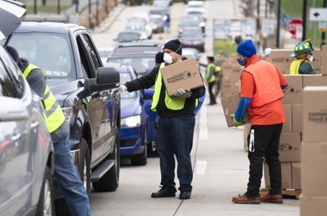
Other Programs
Drive-Up Distributions
Child Nutrition Programs
Pantries and Pantry Locator
Senior Box Program

Slide 6

SNAP Outreach & Application Assistance

Slide 7
What We Do
We Can Assist You By:
  Submit new SNAP applications​
  Submit SNAP renewals​
  Apply for LIHEAP and Medical benefits​
  Provide information/ register for Food Bank programs
  Register clients for programs such as ERAP, certain employment programs and reduced cost internet
  Upload client documents​
  Explain and assist with the application process​
We Cannot:
  Approve applications​
  Modify active SNAP cases​
  Search for SNAP accounts not created through GPCFB
  Send EBT cards, new or lost​
  *For question about active cases and lost cards, we advise clients to call 1-877-395-8930
We refer clients to 877# or their local CAO, depending on needs.

Slide 8
Why GPCFB Offers SNAP Application Assistance
We hold a state contract in 8 counties in our 11-county service area
This contract allows community partners to provide application assistance in an attempt to alleviate strain on CAOs
We have been offering SNAP application assistance consistently each year since 2014

Slide 9
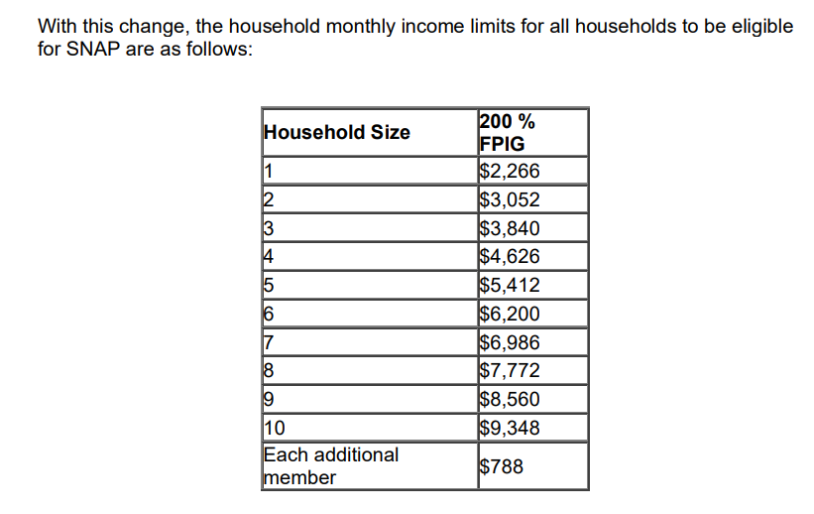
SNAP Income Guidelines
Effective October 1st 2022

Slide 10
Compass Programs
SNAP
Medical Assistance
LIHEAP
LIWAP
Child Care Works
Cash Assistance (TANF)
Long-term living
ERAP

Slide 11
Why Become A Compass Community Partner?
Ease of application for clients
Track applications completed more easily
Follow up with clients on completed applications
Upload documents for clients

Slide 12
Useful Links
Compass: www.compass.state.pa.us
Pittsburgh Food Bank: www.pittsburghfoodbank.org
SNAP handbook: http://services.dpw.state.pa.us/oimpolicymanuals/snap/index.htm#t=535_Employment_and_Training_Requirements%2FTitle_Page.htm

Slide 13
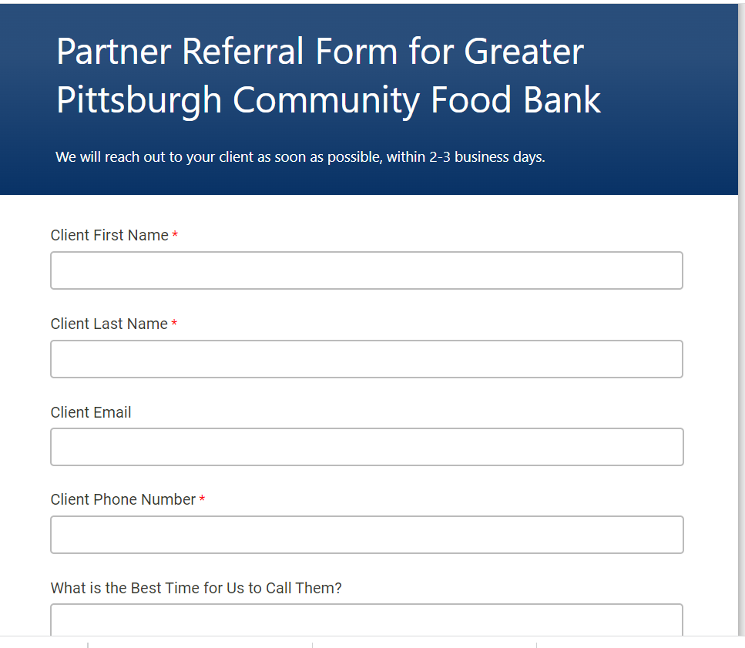
Reach Us Online: Partner Referrals
pittsburghfoodbank.org/referral
Preferred referral method!
This gives credit to your organization for each referral you send
Complete the online form and our staff will be notified​
One of our skilled application assistants will call you within 2 business days. ​

Slide 14
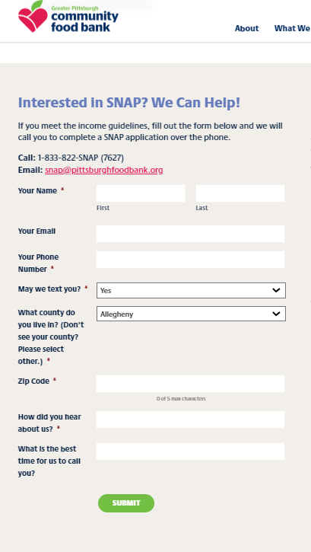
Reach Us Online: Public
pittsburghfoodbank.org/SNAP​
This method is for the public, so you could provide this link to clients
Go to the “Get Help” button at the top of our website​
Click the large SNAP Icon ​
Complete the online form and our staff will be notified​
One of our skilled application assistants will call within 2 business days. ​

Slide 15
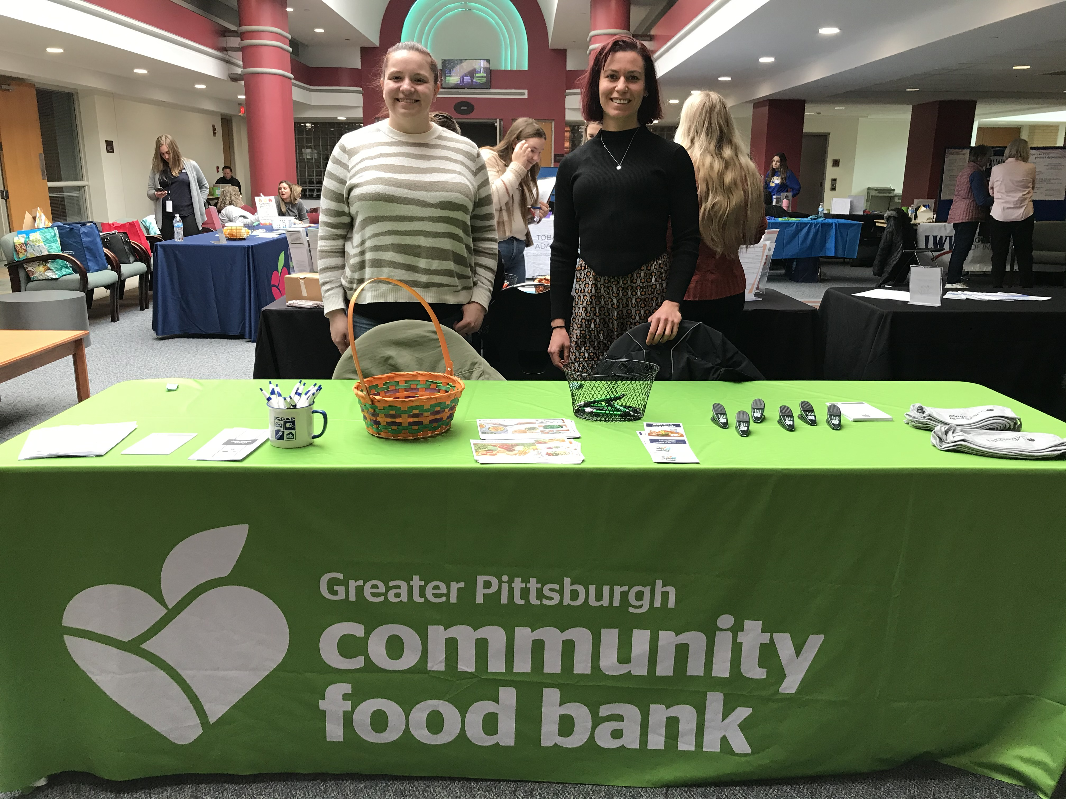
Let's Collaborate
General Collaboration: Chris West
cwest@pittsburghfoodbank.org
Allegheny: Dionna Rojas
drojas@pittsburghfoodbank.org
General and Cambria, Indiana: Keelan McDonald
Kmcdonald@pittsburghfoodbank.org
Beaver/Butler: Patricia Ferricks
Pferricks@pittsburghfoodbank.org

Slide 16

Questions?
Feel free to send questions and referrals via email to:​
​
snap@pittsburghfoodbank.org​
​

