Slide 1
Car Seats & Cribettes
January 25th, 2023

Slide 2
Agenda
1) Overview
2) Request and Distribution Processes
3) Overview of Materials
4) Questions

Slide 3
Car Seats & Cribettes
DHS is providing a supply of car seats and cribettes (aka pack n plays) that will be stored at regional locations
These items are available to families in need as crisis prevention
Requests for these items may come from Family Centers, Hello Baby partners, ELRC or DHS Resource Navigators

Slide 4
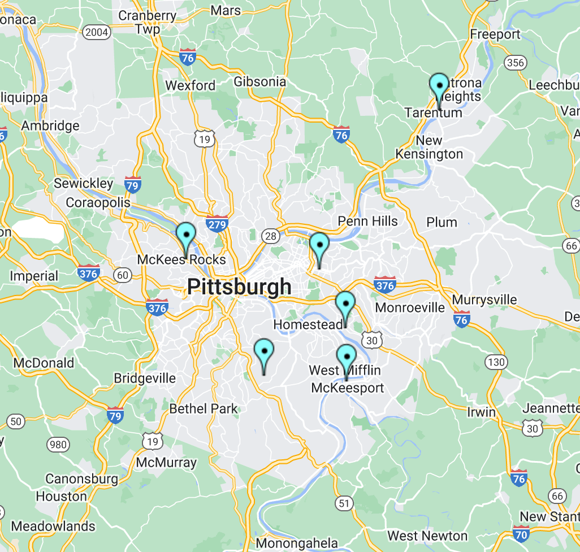
Distribution Sites
Braddock*
Highlands
Homewood
McKeesport
McKees Rocks
South Hills
*Braddock will only distribute car seats and cribettes to other FCC sites*

Slide 5
Who are these items for?
Families do not need to be "enrolled" at the center to receive these items.
Staff must have had contact and been engaged with them so we can ensure follow-through on the request.
These items should be for families who have no other options
I.e., not to be used as a second car seat for a caregiver or a travel crib!
Requests should be parent-driven!
We are not advertising these items widely and the Hello Baby Outreach Team is not offering these items to families.
Foster families can receive these items through CYF
please refer foster families to their caseworker
These items are NOT an incentive (like YOC or diapers)
Prioritize Hello Baby families since they've been identified as having the highest need (but any family is eligible)

Slide 6
How does the request process work?
1) Family expresses need
2) Staff offers the item/items. Staff should note the request is subject to approval.
3) Staff complete the Qualtrics form.
4) The Qualtrics form will be reviewed and the request will be approved/denied.
5) Claire will send a confirmation email to the requestor and the distribution site.
6) The distribution site will coordinate a pickup day/time with the requestor within one week/5 business days.
7) The requestor (or other designated staff) will pick up the item.

Slide 7
Once the requestor has picked up the item:
1) Items should be provided to the family within one week/5 business days (pickup or delivery)
2) Family must complete the following items
Review of manuals
Sleep ambassador training video
Review and sign the agreement
3) Staff member collects agreement and submits to Claire (claire.wever@alleghenycounty.us)

Slide 9
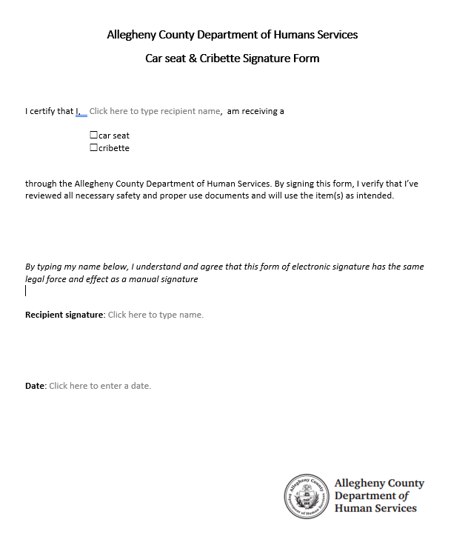

Slide 10
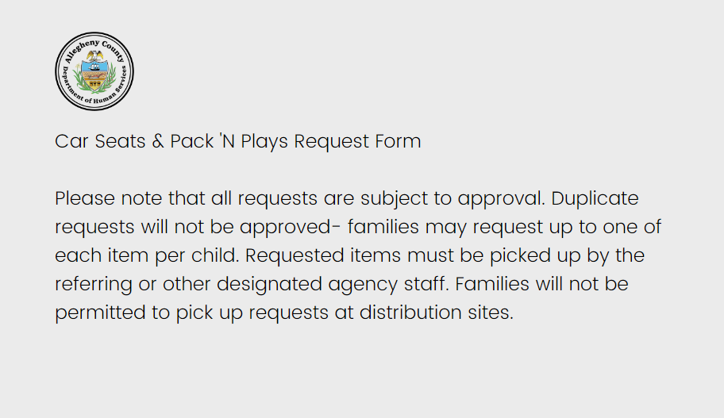
Request Form Overview

Slide 11
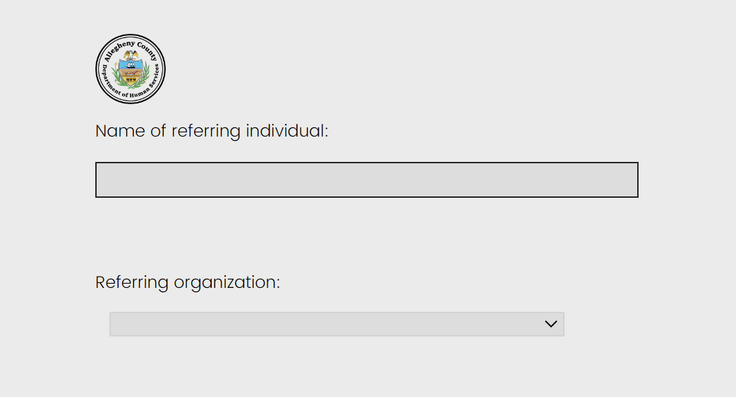
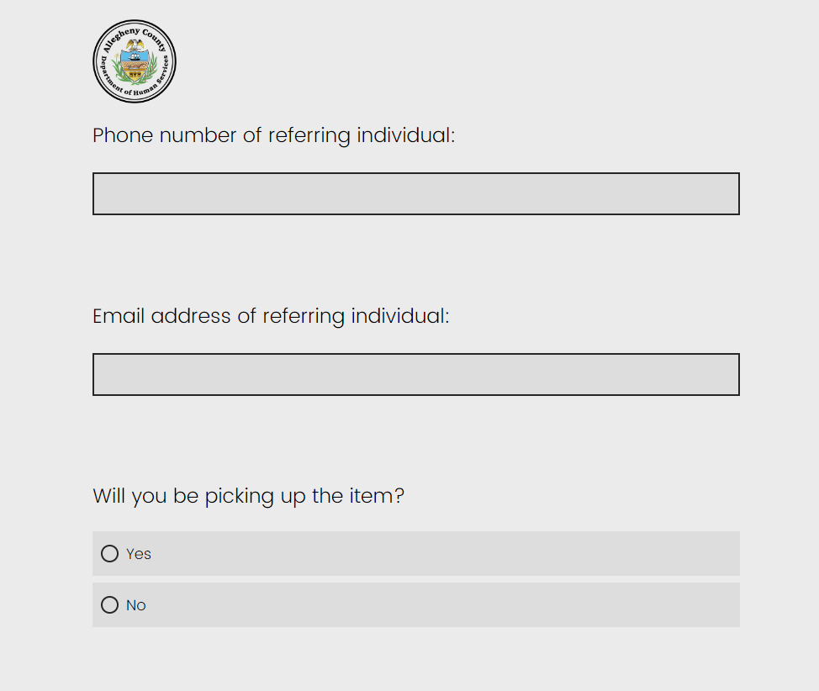
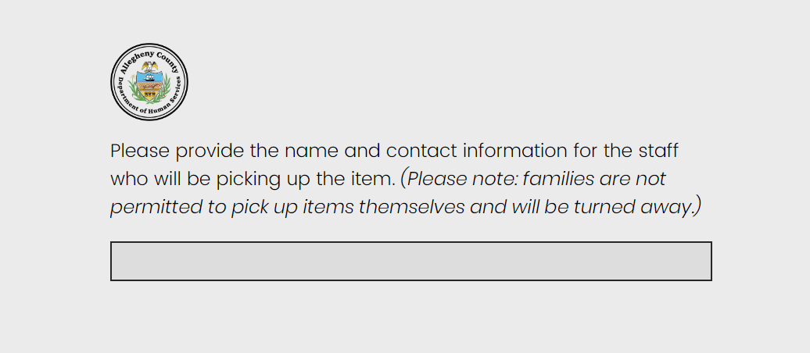

Slide 12
Safety Videos
Rear-Facing Convertible with Seat Belt
Rear-Facing Convertible with LATCH
Cribette Instructional Video

Slide 13
Questions?

